Slide 1
generate presentation about blochchain technology , when it started , how it works , the main goal of it - Comprehensive Analysis
Strategic Insights and Forecast

Slide 2
Introduction
Overview of generate presentation about blochchain technology , when it started , how it works , the main goal of it
Key objectives and goals
Importance in the current context

Slide 3

Introduction - Visual

Slide 4
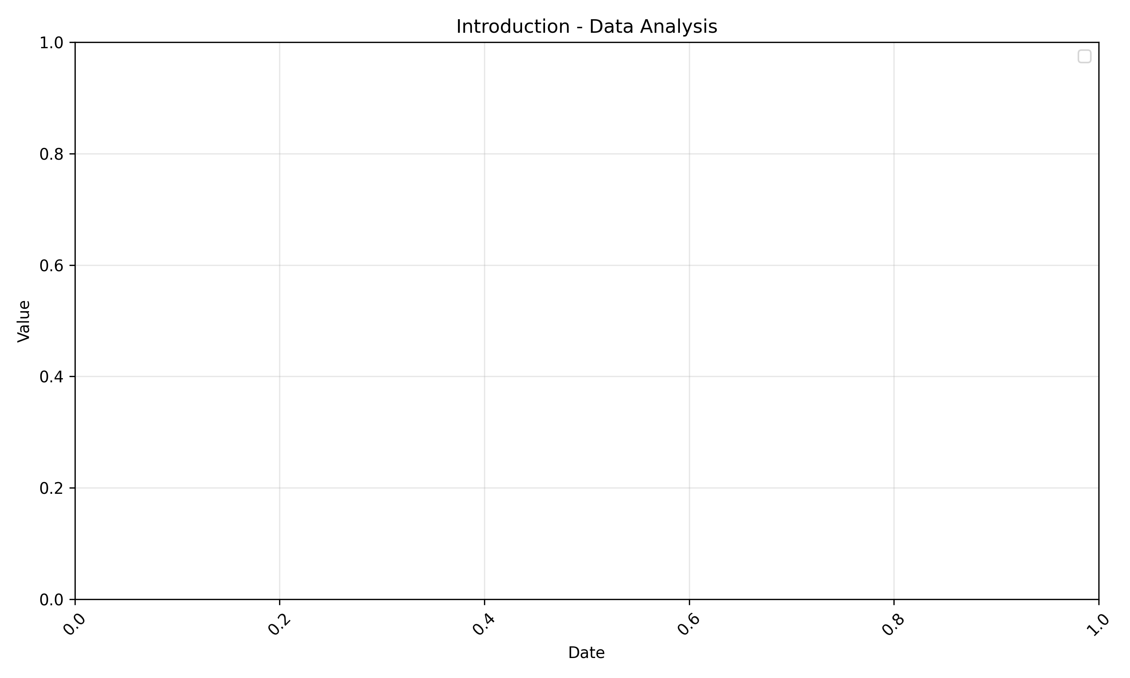
Introduction - Analytics
Data analysis with historical trends and forecast

Slide 5
Market Overview
Current market landscape
Key market trends and developments
Market size and growth projections

Slide 6
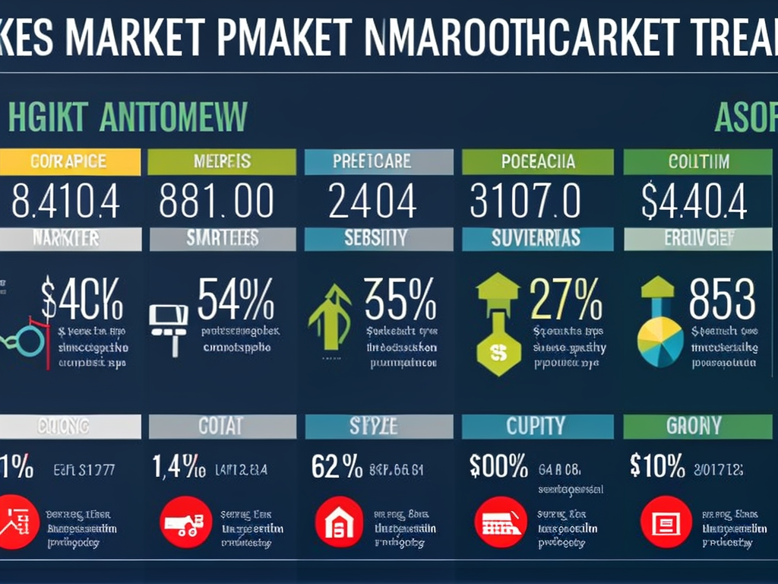
Market Overview - Visual

Slide 7
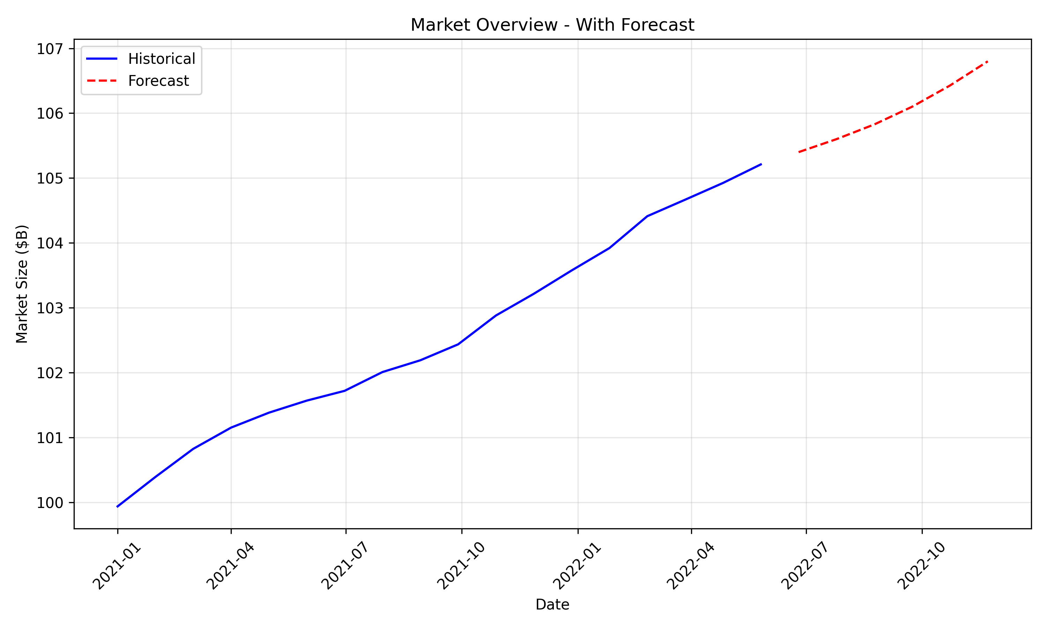
Market Overview - Analytics
Data analysis with historical trends and forecast

Slide 8
Key Components
Core elements of generate presentation about blochchain technology , when it started , how it works , the main goal of it
Important features and technologies
Integration points with existing systems

Slide 9

Key Components - Visual

Slide 10
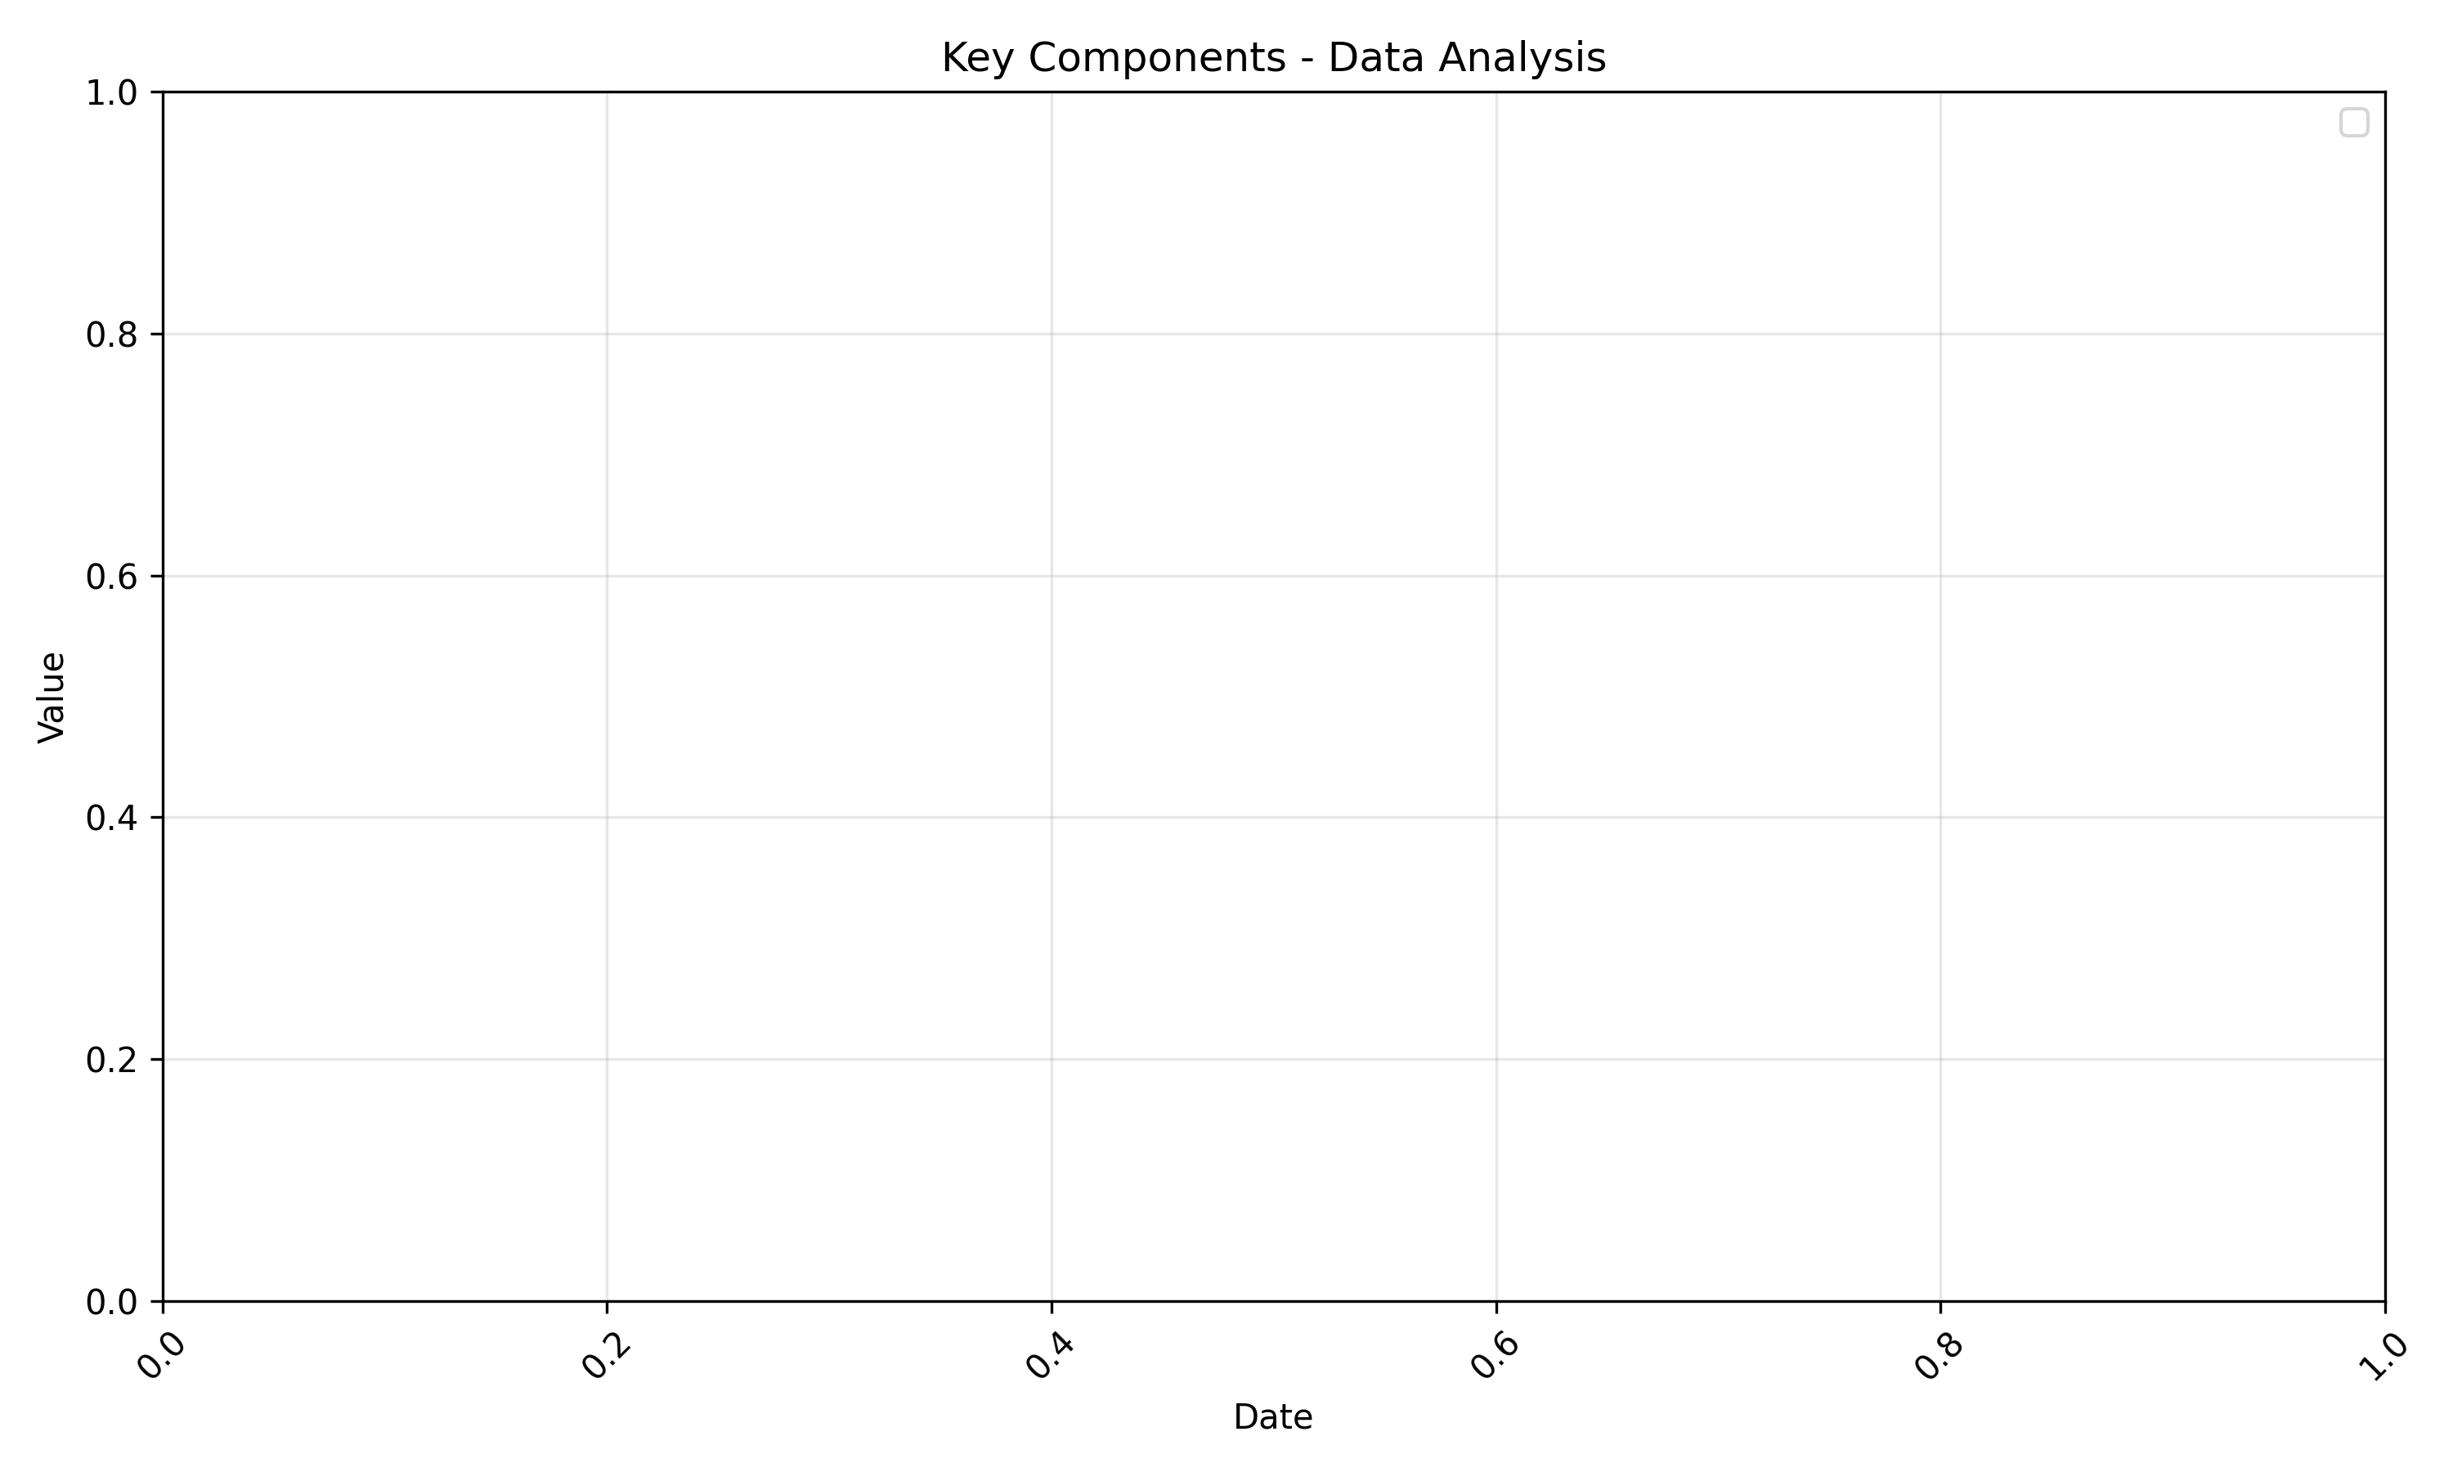
Key Components - Analytics
Data analysis with historical trends and forecast

Slide 11
Data Analysis
Historical performance metrics
Comparative analysis with industry benchmarks
Key insights from data

Slide 12
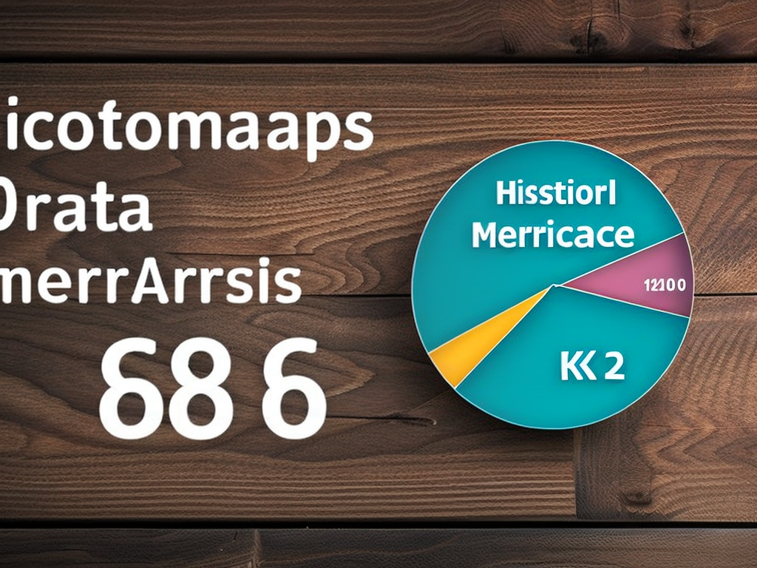
Data Analysis - Visual

Slide 13
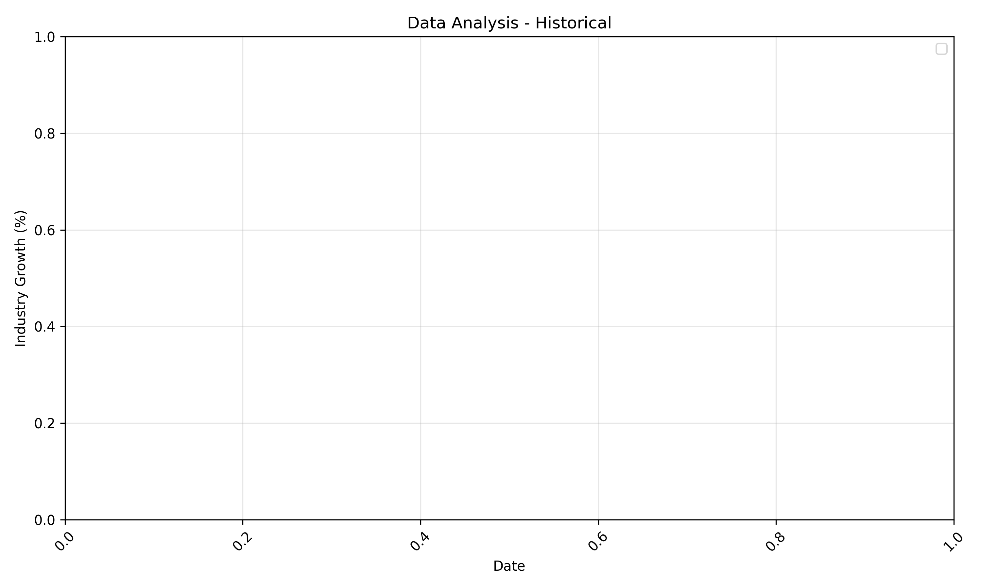
Data Analysis - Analytics
Data analysis with historical trends and forecast

Slide 14
Future Trends
Emerging trends in generate presentation about blochchain technology , when it started , how it works , the main goal of it
Short-term predictions (1-2 years)
Long-term forecast (3-5 years)

Slide 15
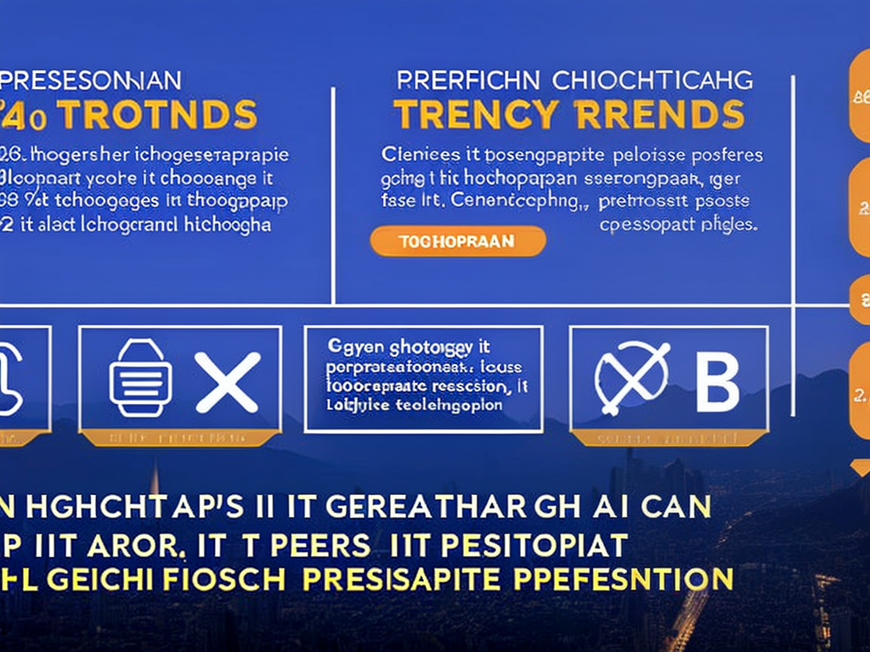
Future Trends - Visual

Slide 16
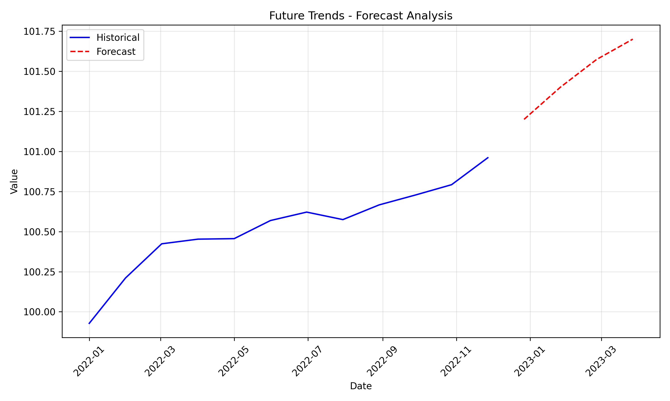
Future Trends - Analytics
Data analysis with historical trends and forecast

Slide 17
Case Studies
Real-world implementation examples
Success stories and outcomes
Lessons learned from implementations

Slide 18

Case Studies - Visual

Slide 19
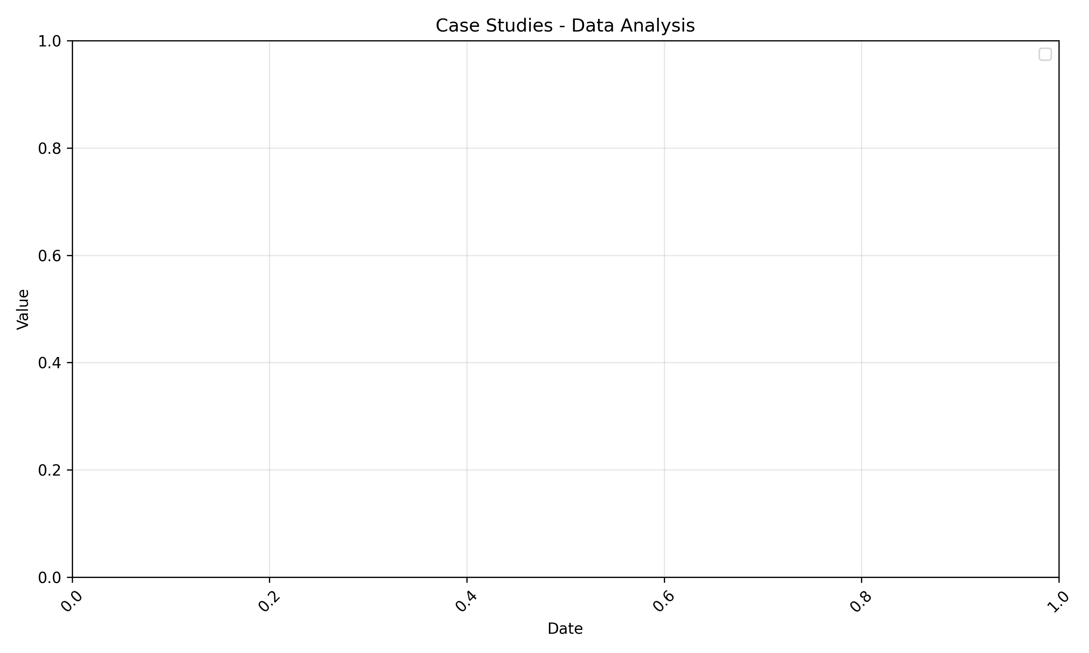
Case Studies - Analytics
Data analysis with historical trends and forecast

Slide 20
Implementation Strategy
Recommended approach for implementation
Timeline and key milestones
Resource requirements and considerations

Slide 21
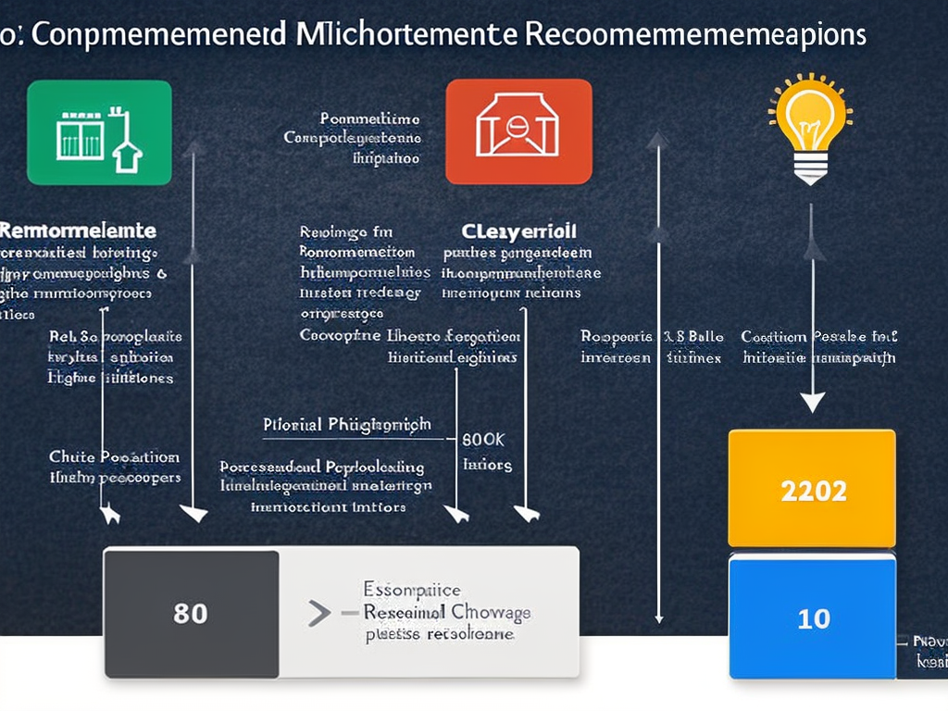
Implementation Strategy - Visual

Slide 22
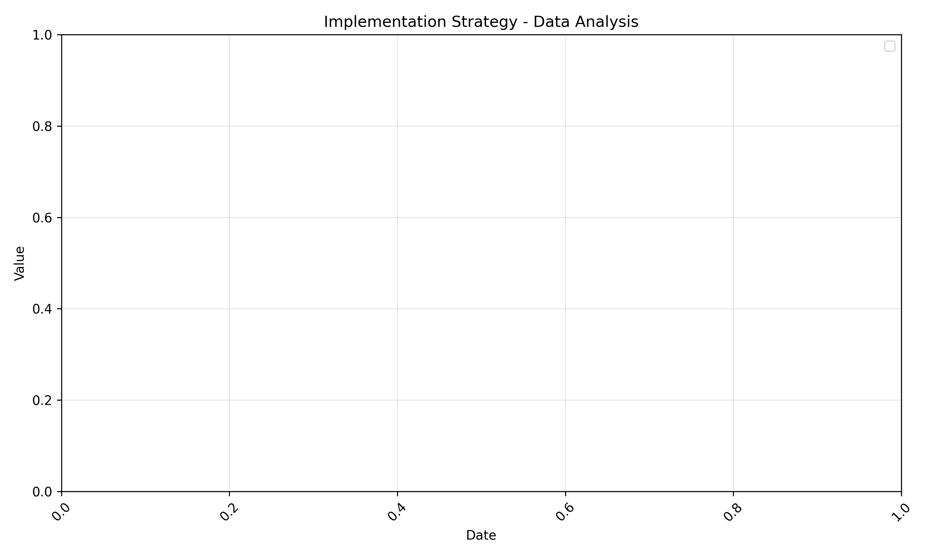
Implementation Strategy - Analytics
Data analysis with historical trends and forecast

Slide 23
Risks and Mitigation
Potential challenges and risks
Mitigation strategies
Contingency planning

Slide 24

Risks and Mitigation - Visual

Slide 25
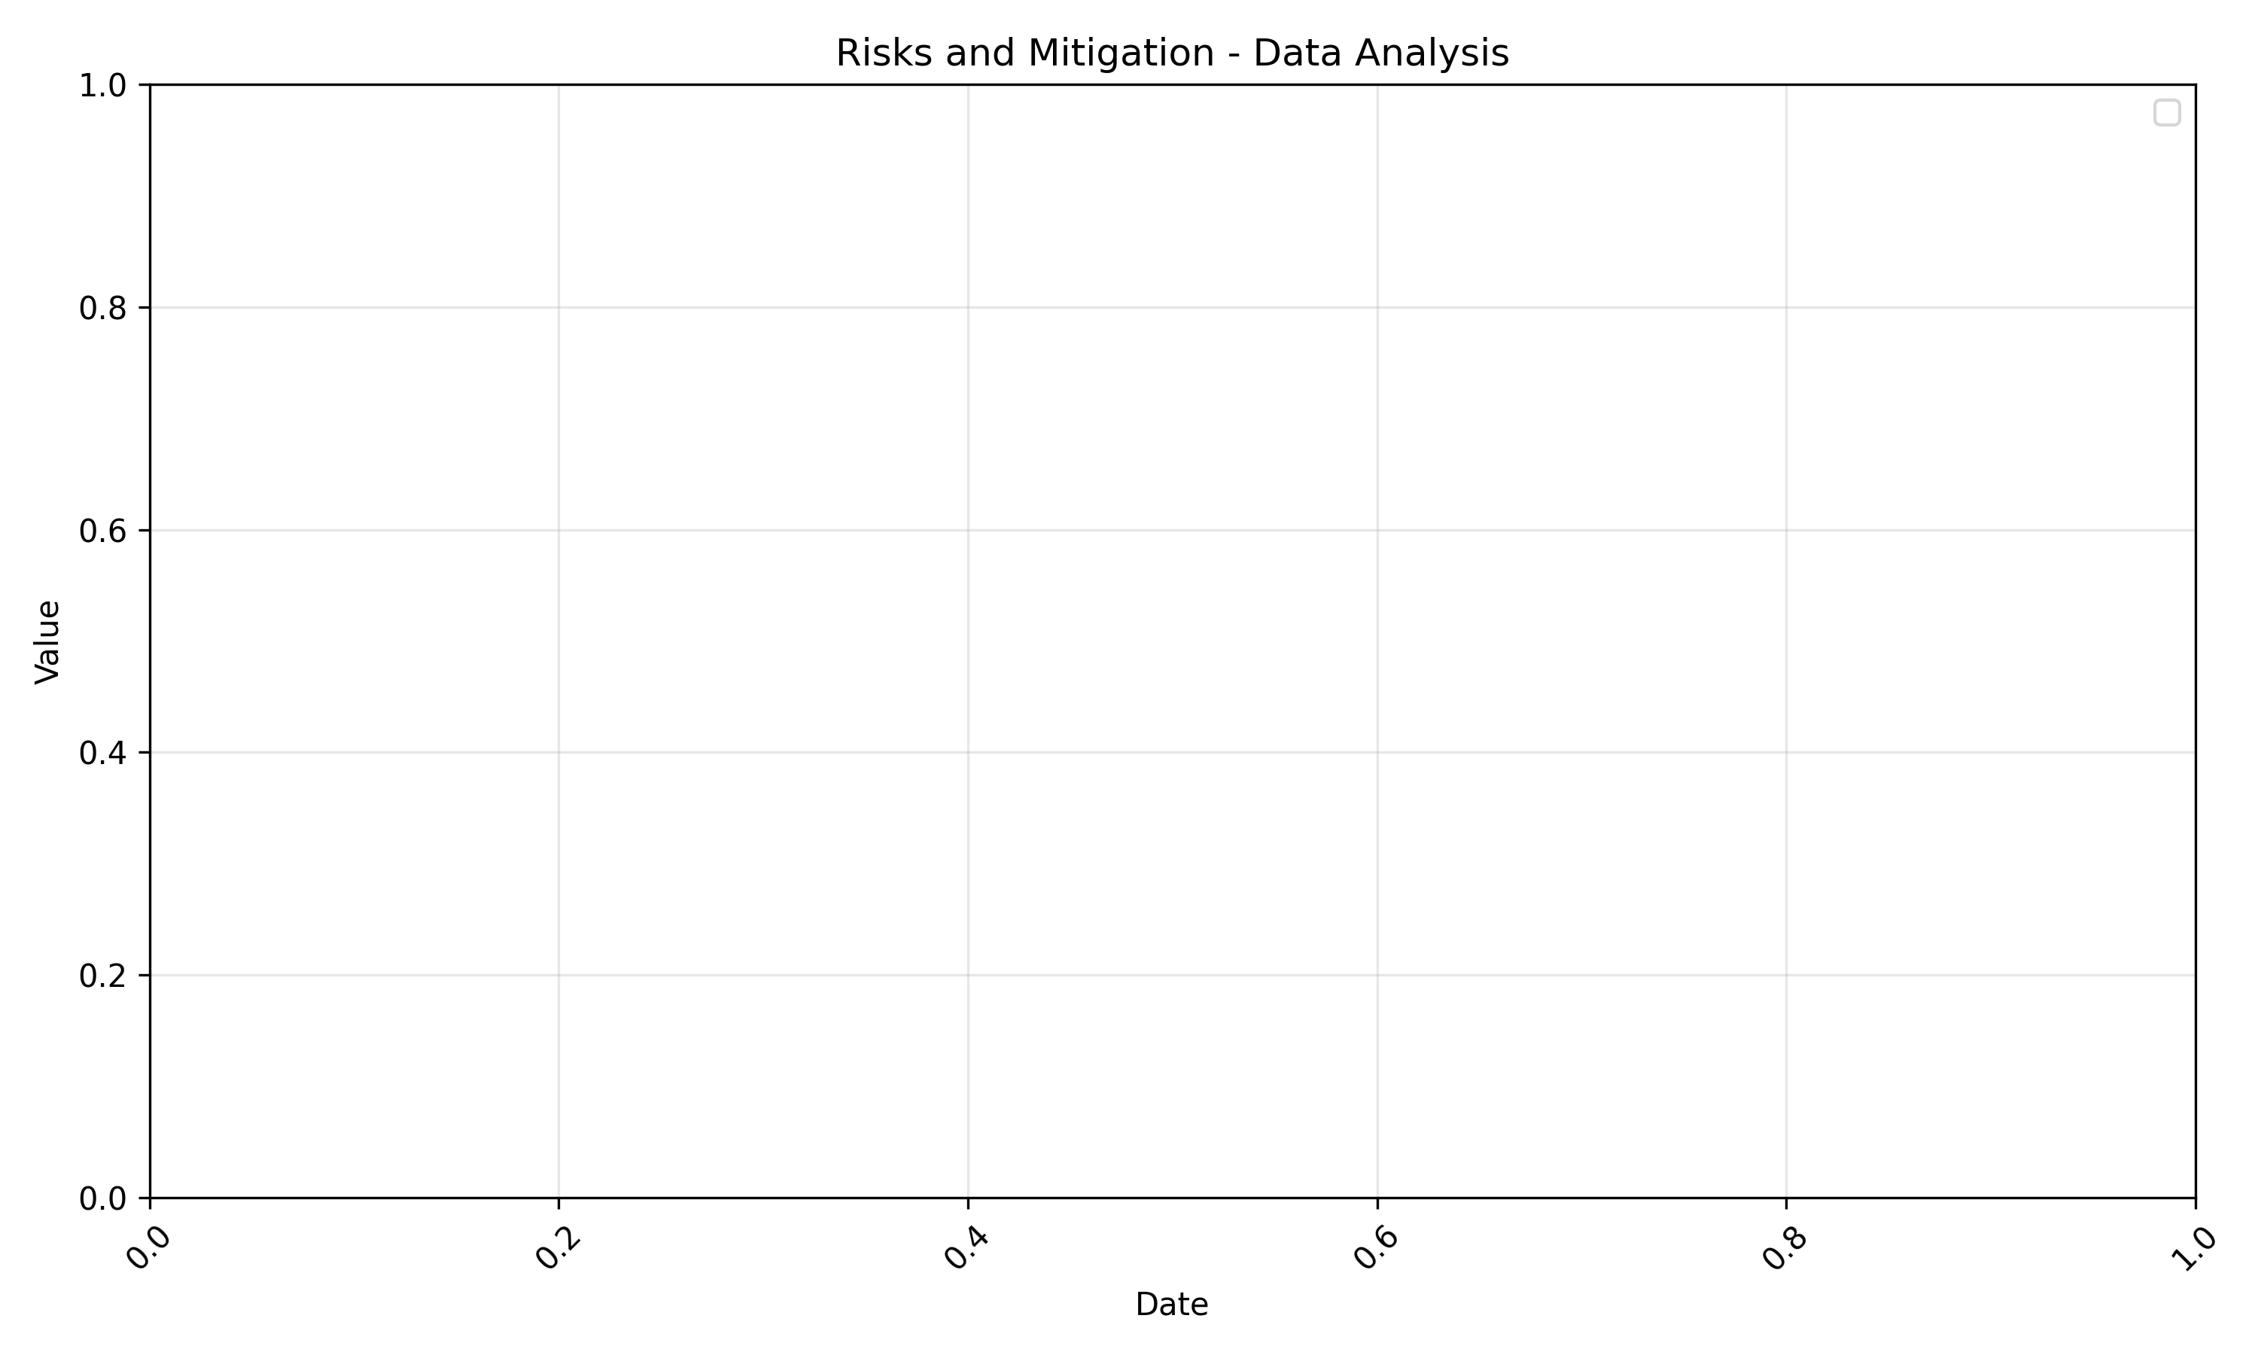
Risks and Mitigation - Analytics
Data analysis with historical trends and forecast

Slide 26
Summary
Key takeaways about generate presentation about blochchain technology , when it started , how it works , the main goal of it
Next steps and recommendations
Questions and discussion

Slide 27

Summary - Visual

Slide 28
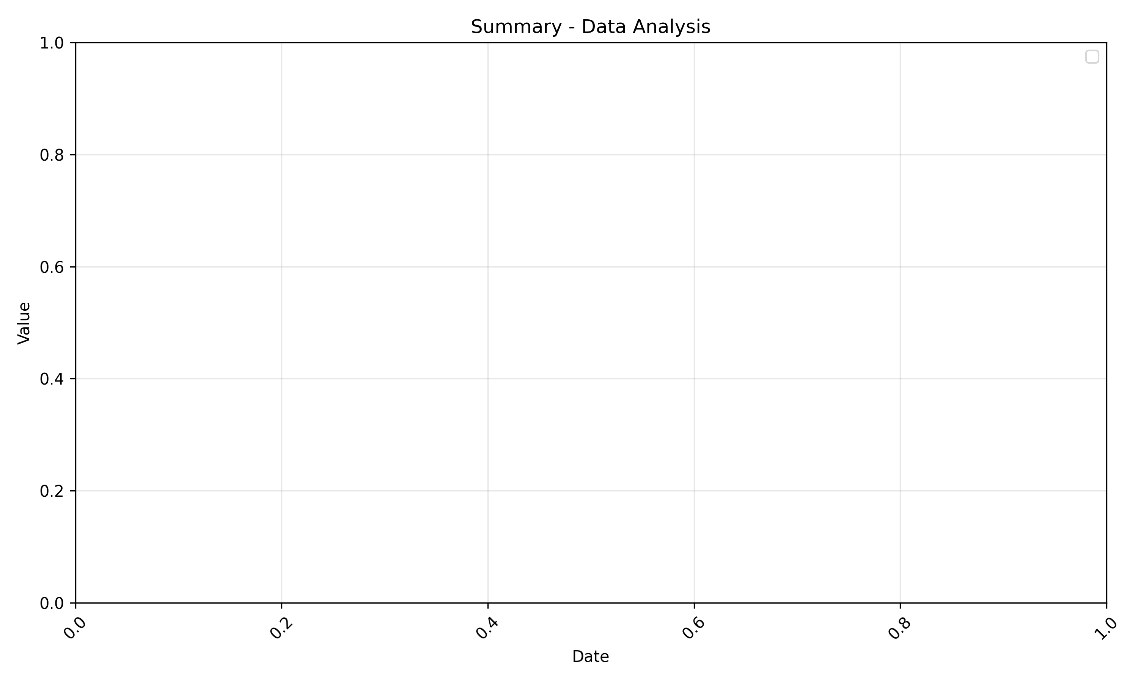
Summary - Analytics
Data analysis with historical trends and forecast

